Slide 1
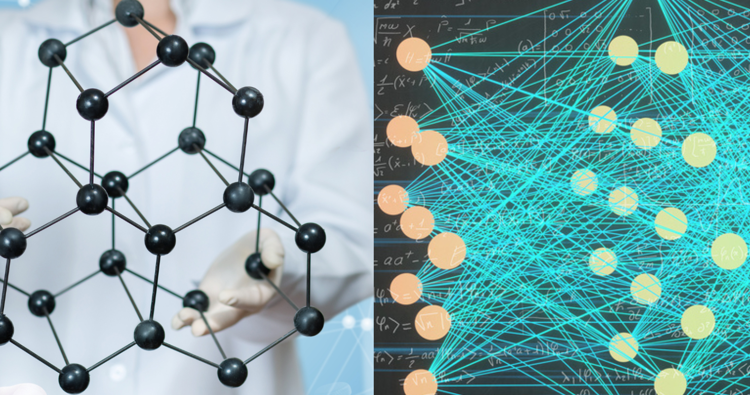

Application of High-Performance Computing and Machine Learning for Characterization of Nanostructures, Composite Materials, and Energy-Conversion Structures
Vasyl Kuryliuk and Oleg Olikh

Slide 2
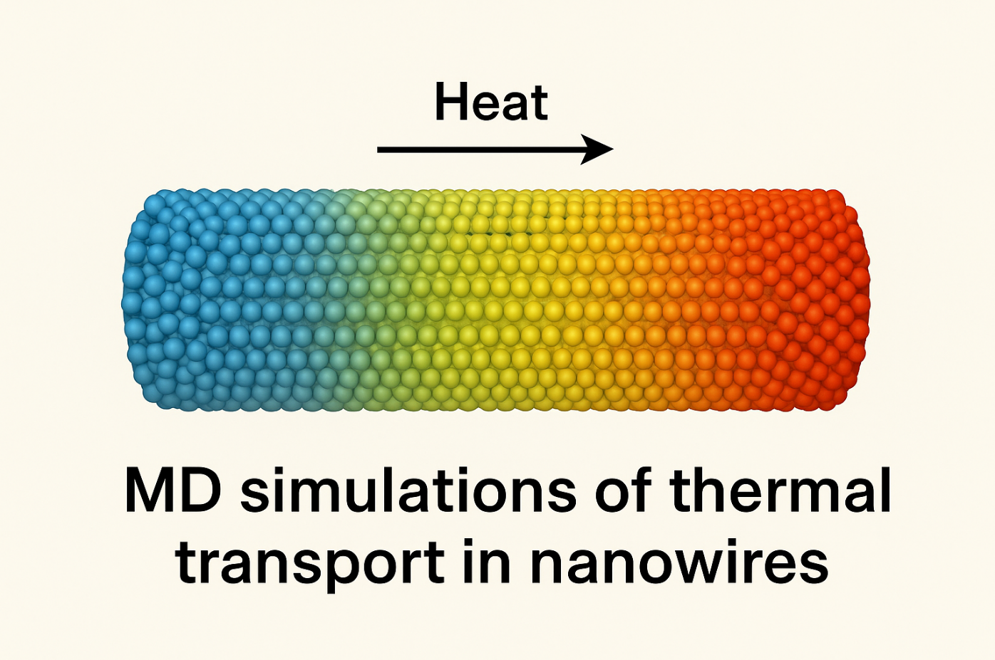
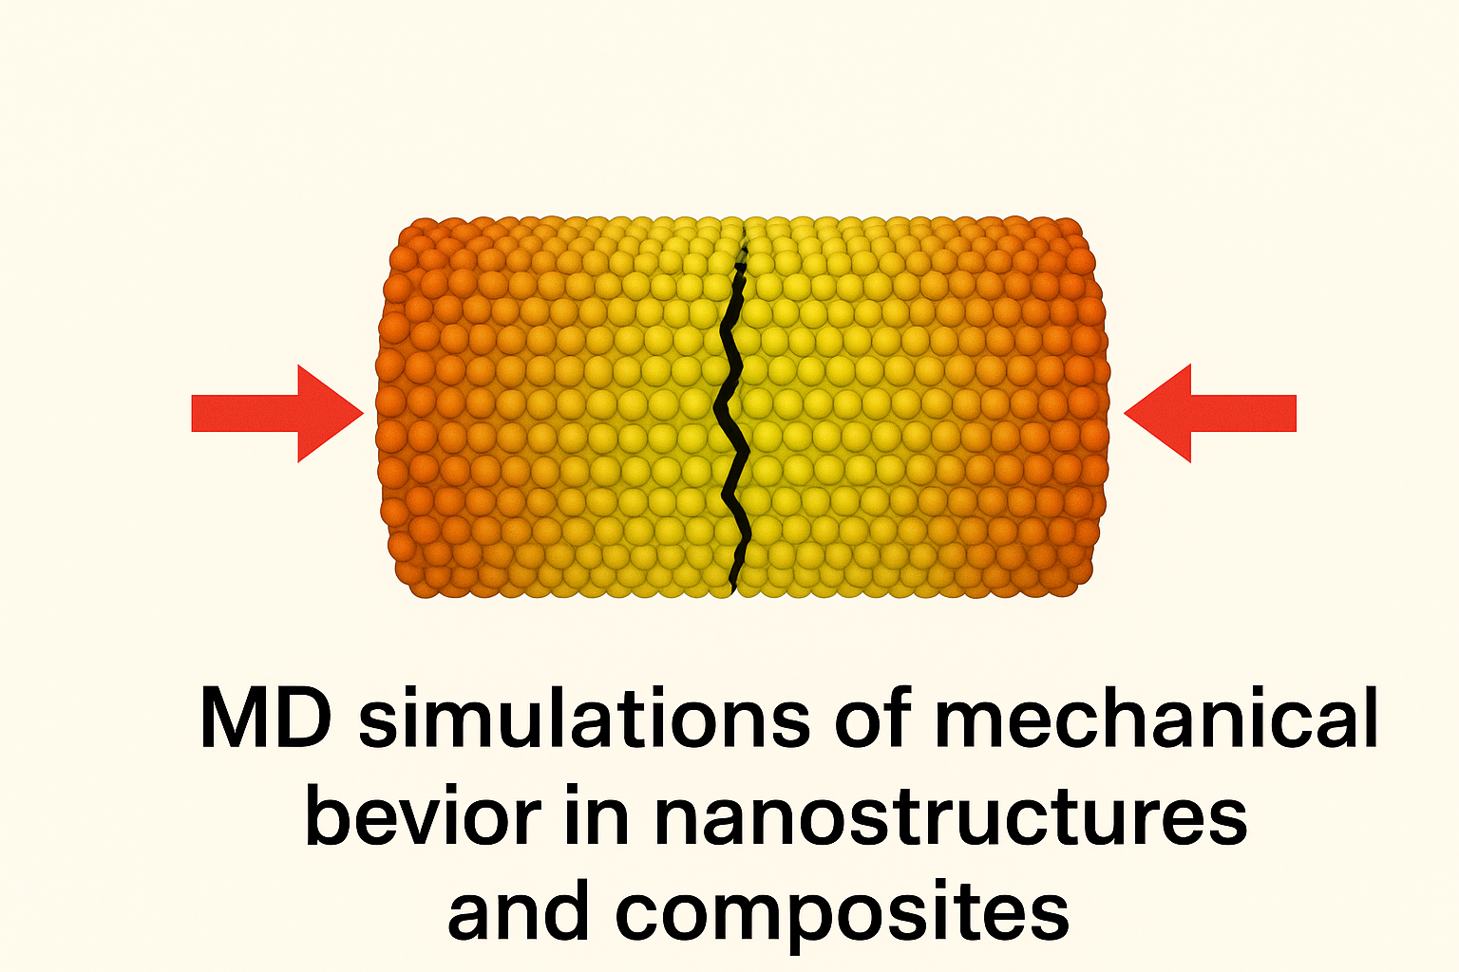
MD Simulations of Thermal Transport and Mechanical Behavior in Nanostructures and Composites

Slide 3
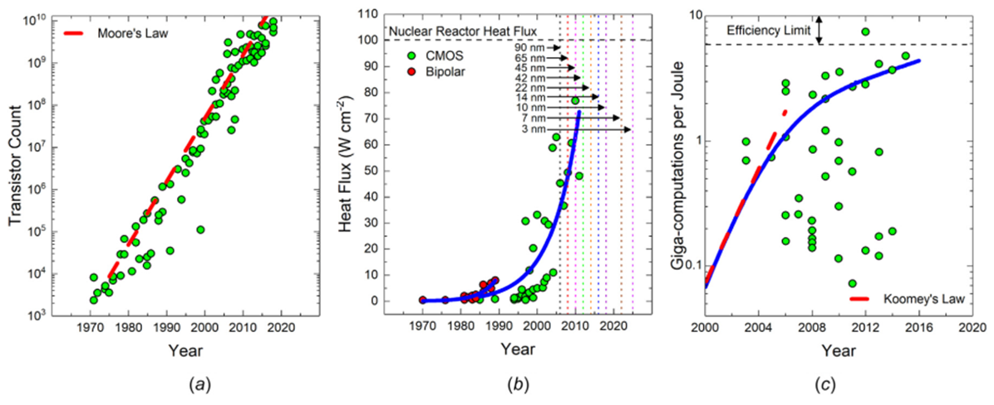
Thermal Transport Modeling: Motivation and Objectives
(a) Growth rate of transistor count in processors (Moore’s law); (b) Historical trend of heat flux in bipolar and CMOS processors; (c) Computational efficiency vs. year and transistor length scale.

Slide 4
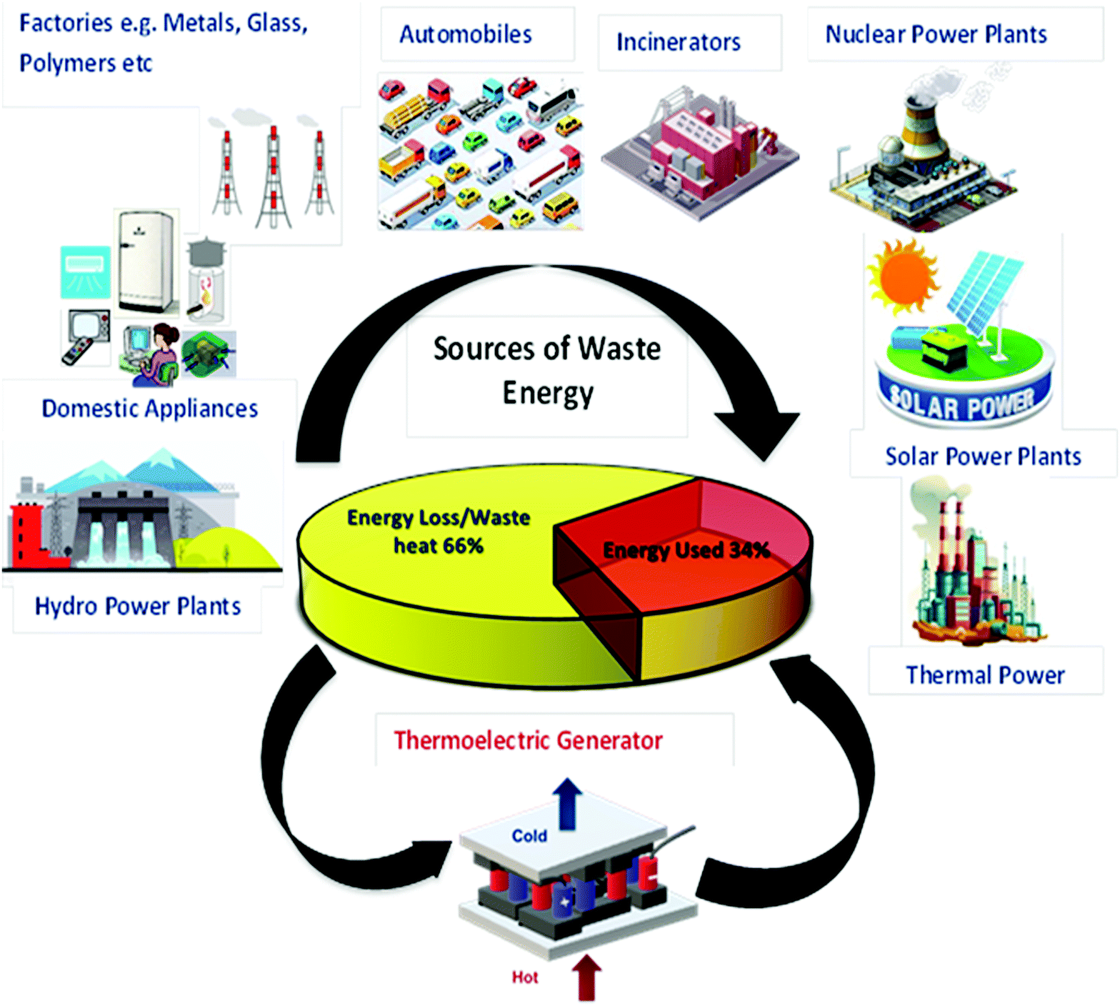
Thermal Transport Modeling: Motivation and Objectives
Schematic of the various types of waste energy sources and utilization of waste heat energy by a thermoelectric generator. (Mater. Adv., 2021, 2, 1927-1956)

Slide 5
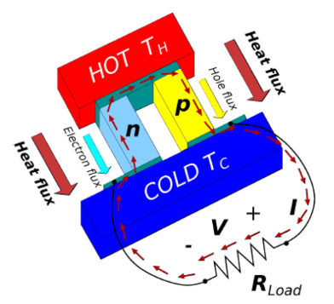
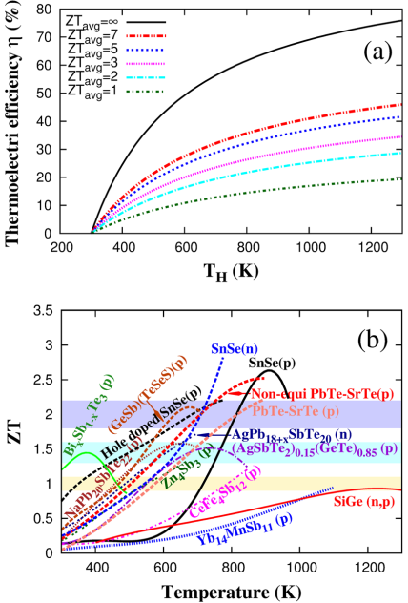
Thermal Transport Modeling: Motivation and Objectives
Thermoelectric efficiency vs. hot-side temperature (Tc = 300 K). The 20–30% range marks the threshold for fossil-fuel replacement.
Figure of merit (ZT) vs. temperature for several typical thermoelectric materials.

Slide 6
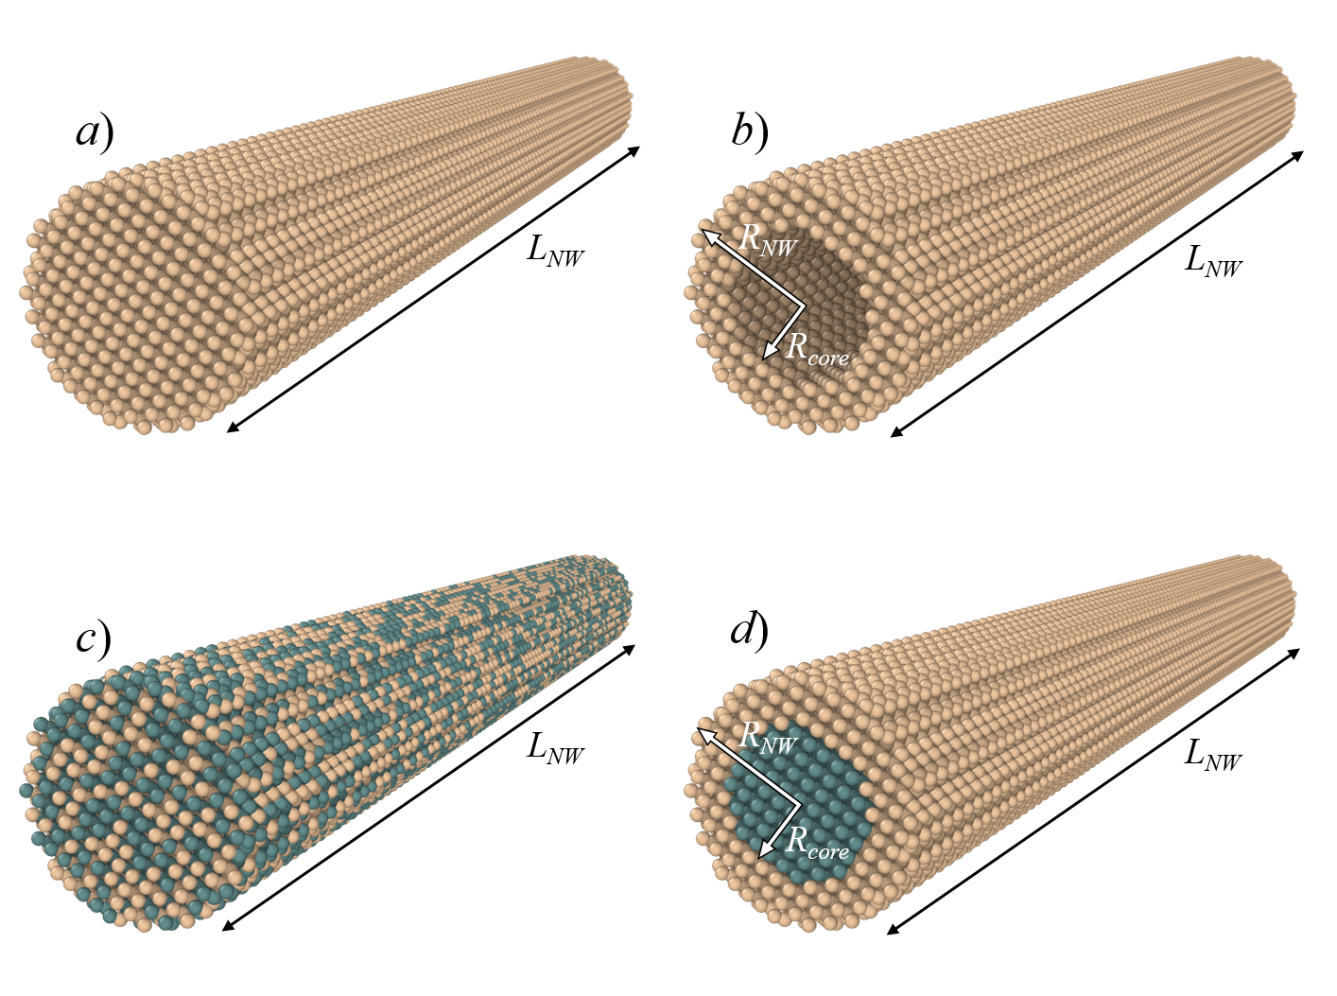
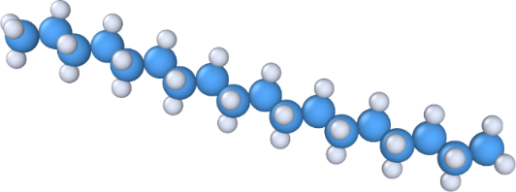
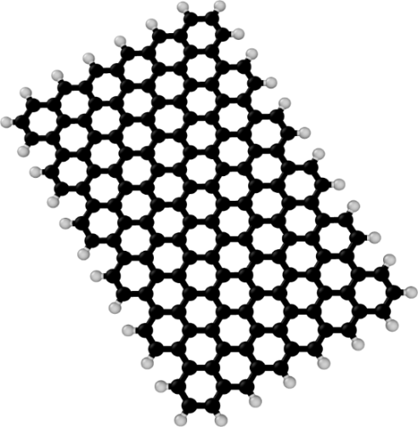
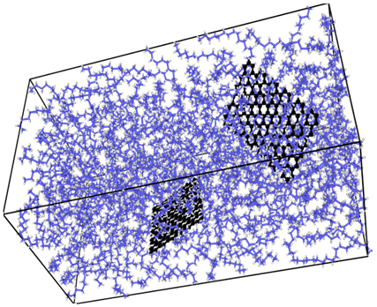
Atomistic Models for Thermal Transport Simulations

Slide 7
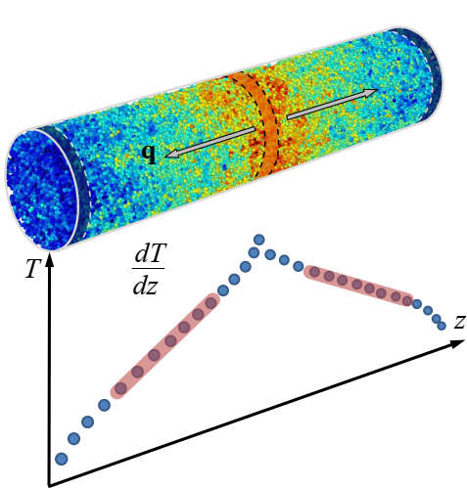
MD Simulation of Thermal Conductivity
NEMD Method for Thermal Conductivity:
Divide the system into thin slabs along the heat flow direction.
Periodically swap velocities between the fastest atom in the cold slab and the slowest atom in the hot slab.
Repeated exchanges create a steady temperature gradient.
Compute heat flux and thermal conductivity from the resulting profile.

Slide 8
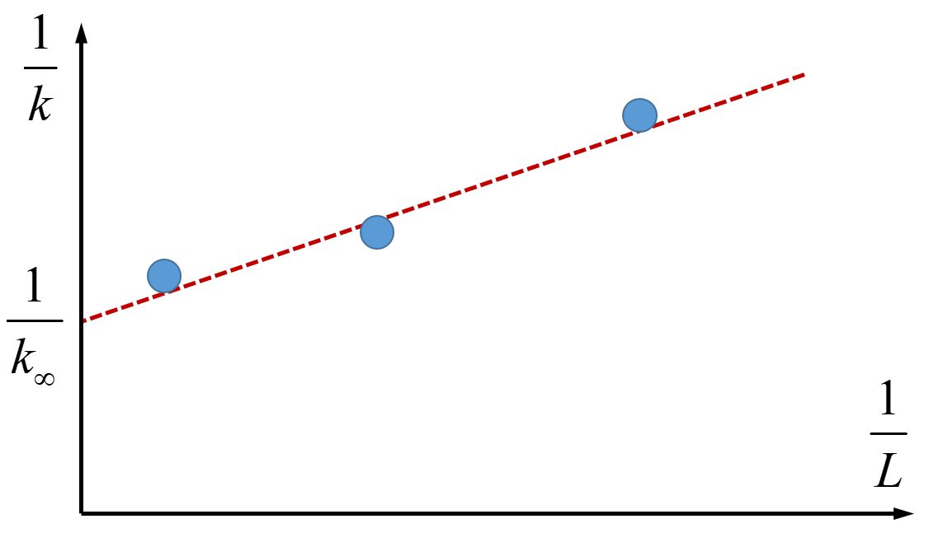
MD Simulation of Thermal Conductivity
L₁
L₂
L₃
Finite-size effects in thermal conductivity calculations using the NEMD method.

Slide 9
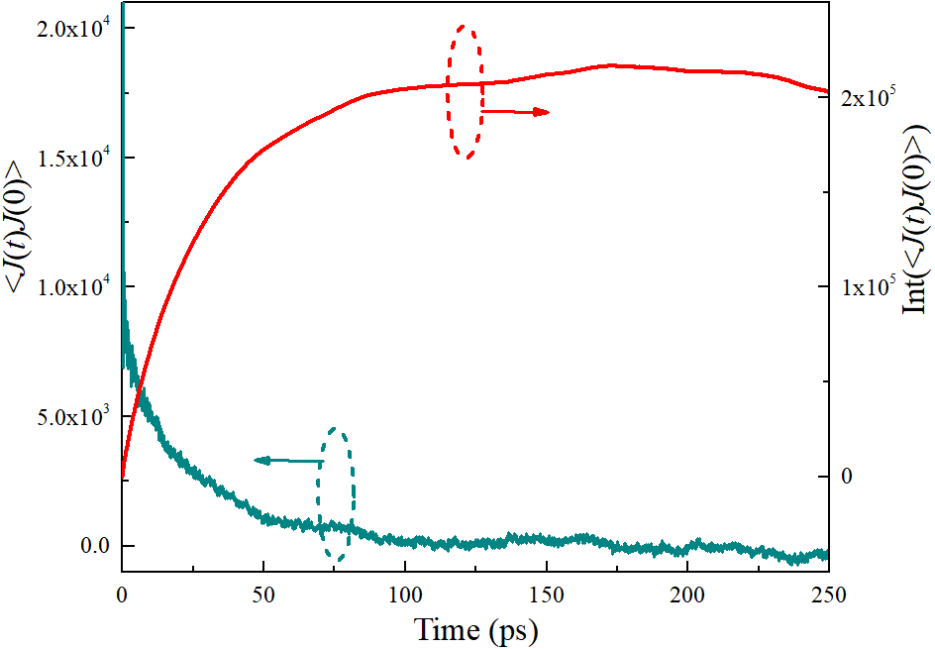
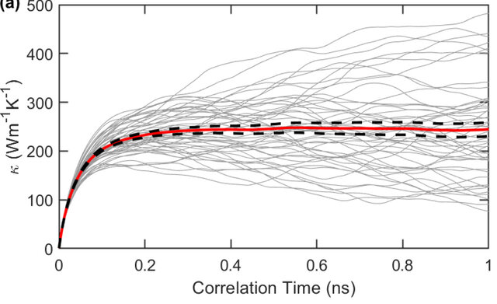
MD Simulation of Thermal Conductivity
Time dependence of the heat flux autocorrelation function and its integral value.

Slide 10
MD Simulation of Thermal Conductivity
Non-Equilibrium Molecular Dynamics (NEMD) Method | Equilibrium Molecular Dynamics (EMD) Method
Higher computational speed for the same number of atoms | Weak dependence of results on system size
Enables calculation of thermal boundary resistance between two materials | Allows calculation of thermal conductivity in all directions within a single simulation
Results depend on the system size | Lower computational speed
Thermal conductivity can be determined only along the imposed heat flow direction | Cannot determine thermal boundary resistance between two materials

Slide 11

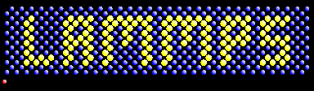
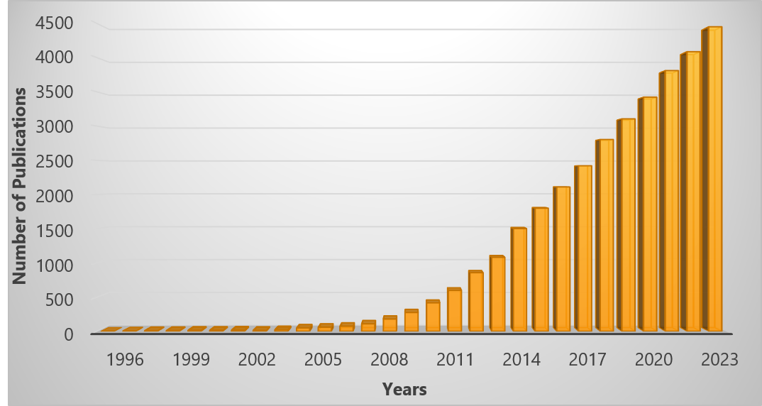
Computational Infrastructure
💎 Versatile molecular dynamics simulator: models solids, liquids, polymers, nanostructures, and biomolecules.
⚙ Supports a wide range of interatomic potentials — classical, reactive (ReaxFF), machine-learned (MLP), and hybrid quantum–classical (QM/MM) models.
⏩ Highly scalable performance — efficiently parallelized for thousands of CPU cores and GPU-enabled clusters.
🔬 Extensible and interoperable — integrates with VASP, Quantum ESPRESSO, ASE, Python interfaces, machine learning libraries, and data analysis tools.
https://www.lammps.org
Number of publications using LAMMPS by year

Slide 12



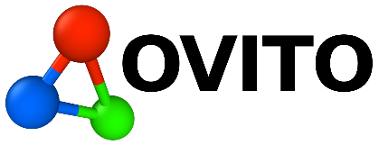
Computational Infrastructure
Tools for Pre- and Post-Processing:
Tool for building, converting, and manipulating atomic structures for simulations
Script-based builder for complex molecular systems and LAMMPS input files
Generates initial atomic configurations by packing molecules without overlaps
Visualization and analysis software for atomistic simulation data

Slide 13
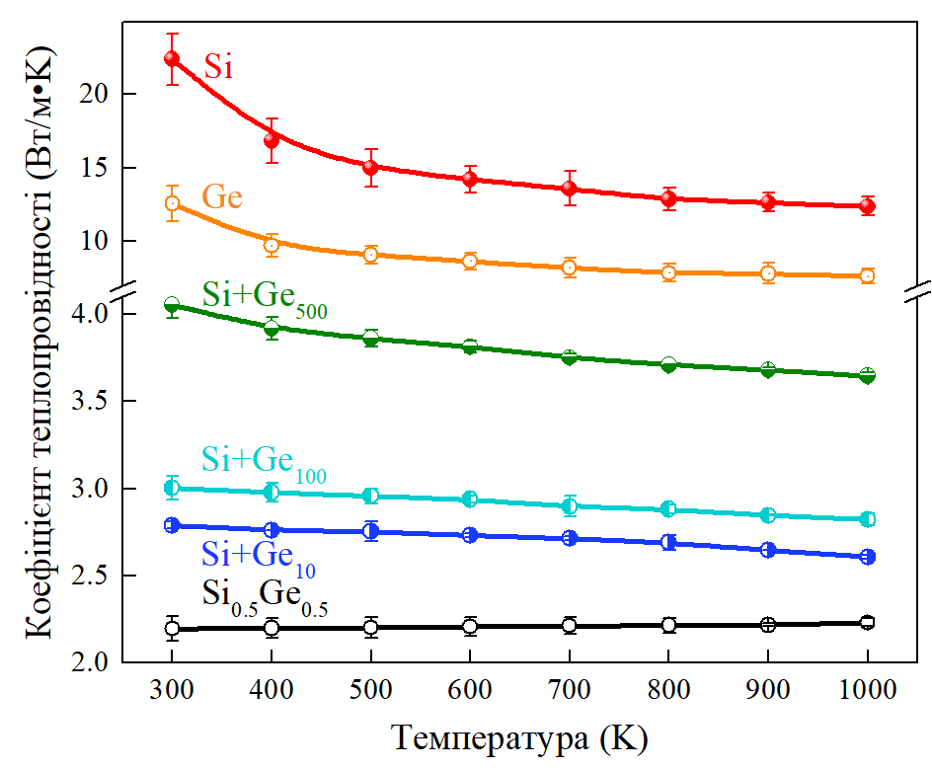
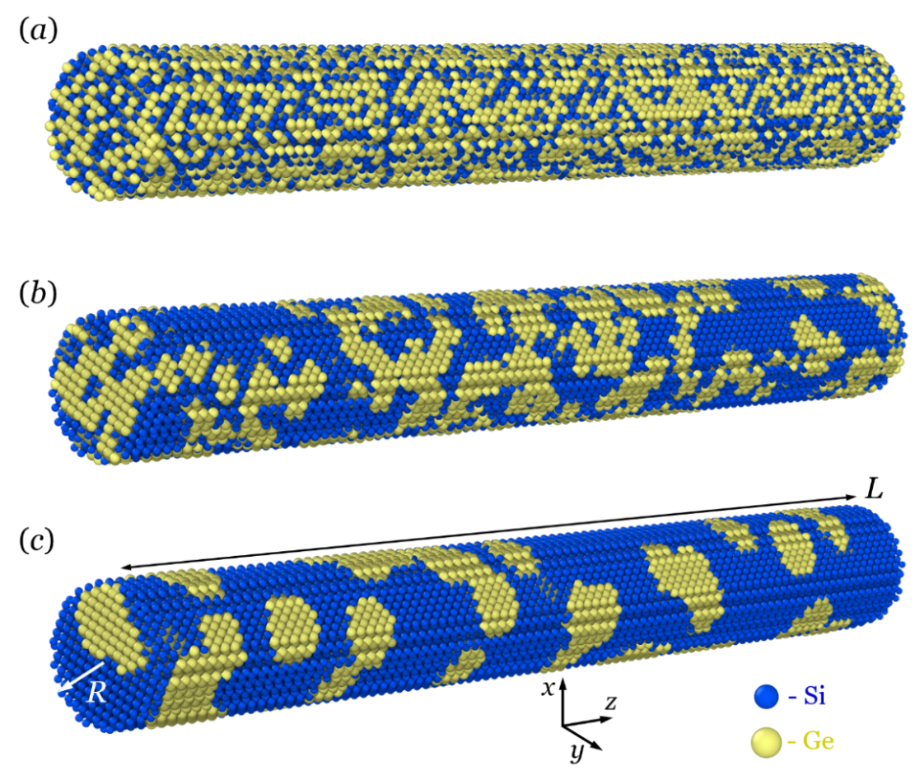
SiGe Nanowires: Results and Analysis

Slide 14
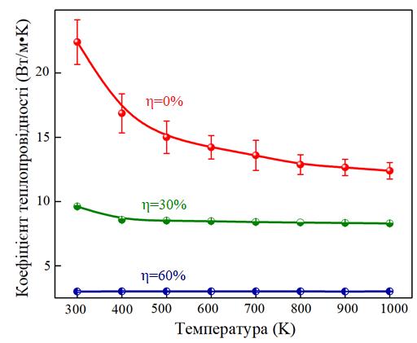
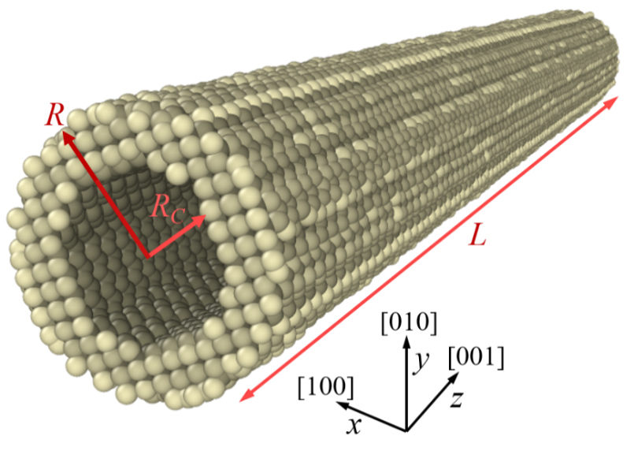
SiGe Nanowires: Results and Analysis

Slide 15
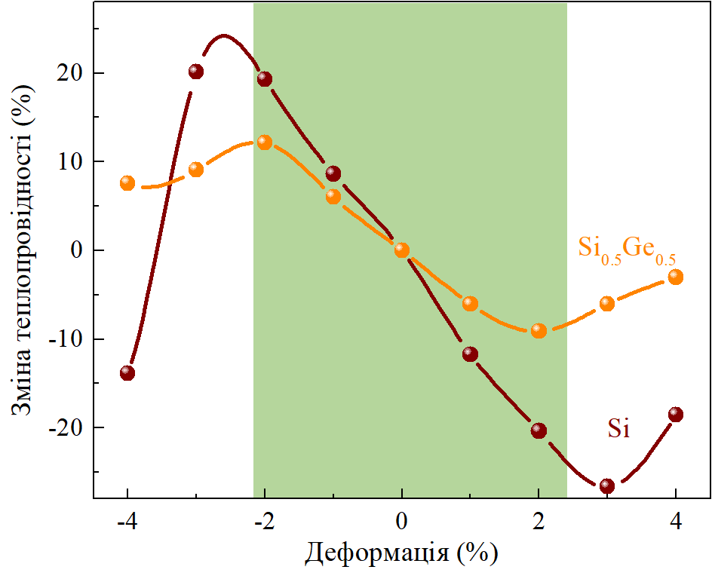
SiGe Nanowires: Results and Analysis

Slide 16
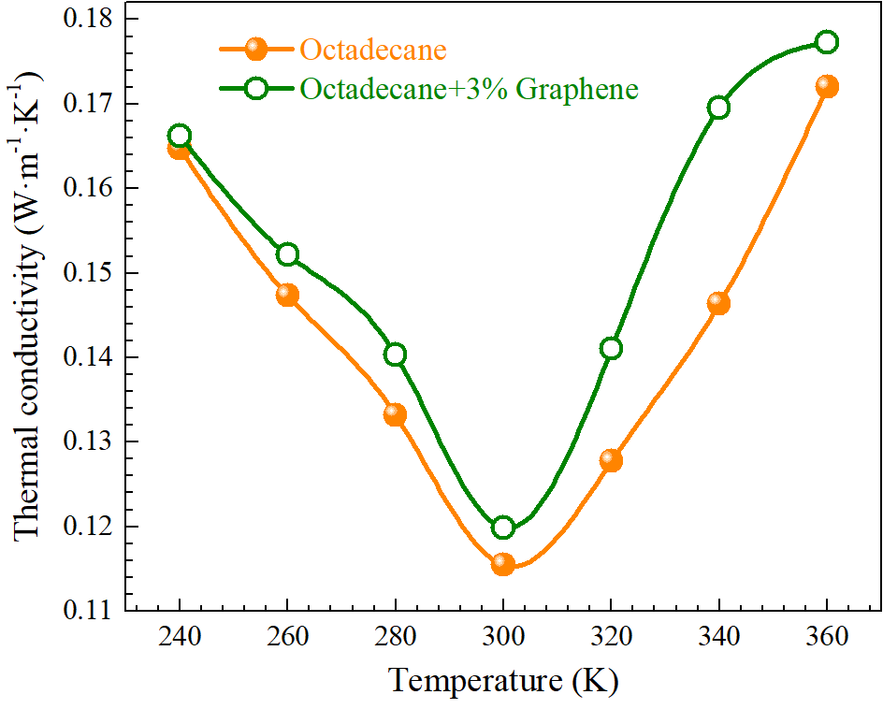
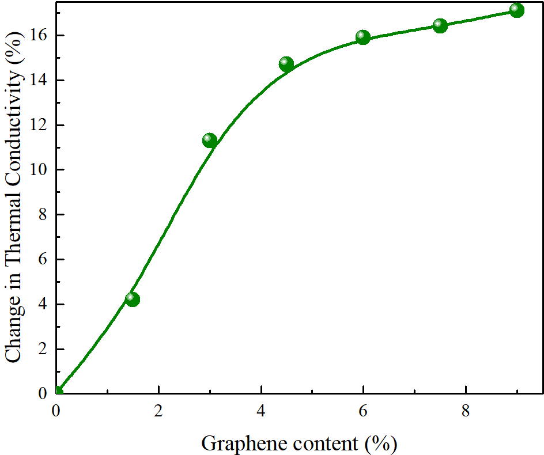
Phase-Change Composites

Slide 17
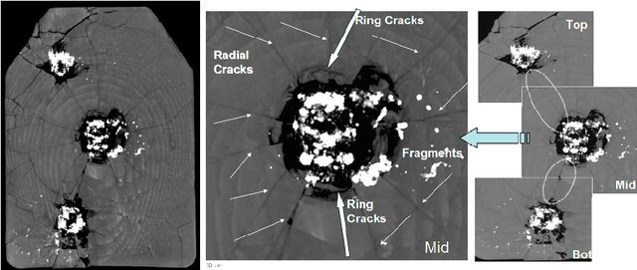
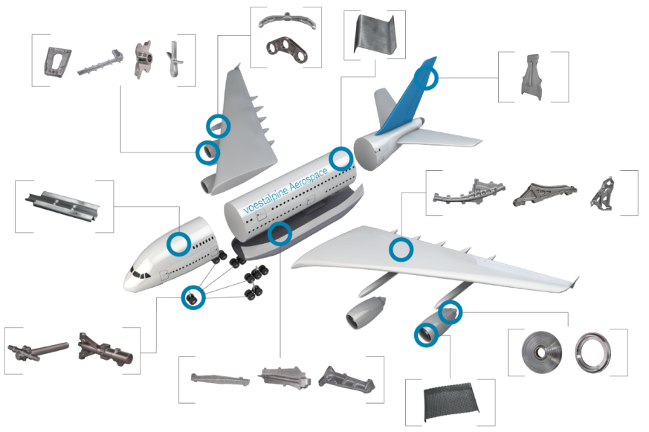
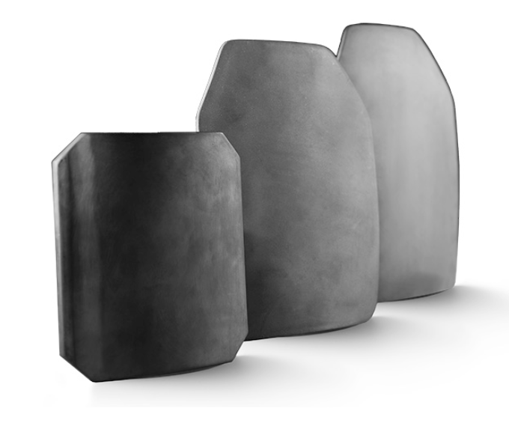
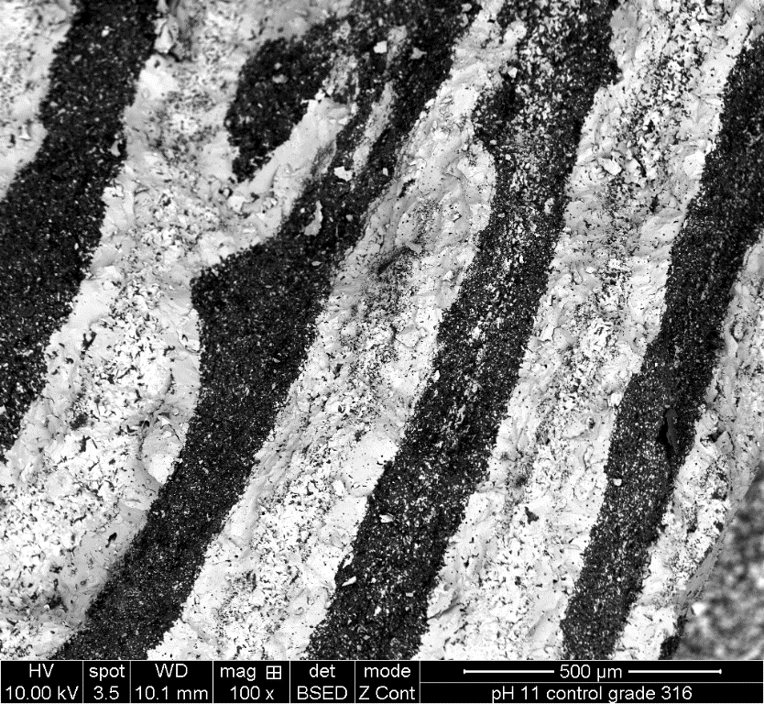
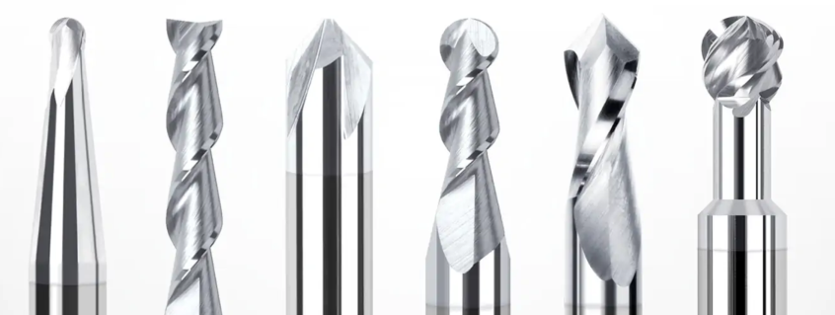
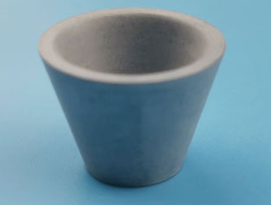
Mechanical Behavior Modeling: Motivation and Objectives

Slide 18
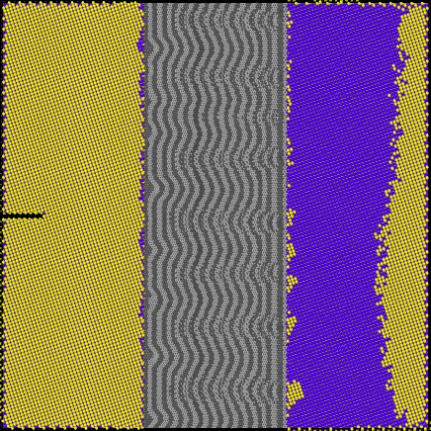
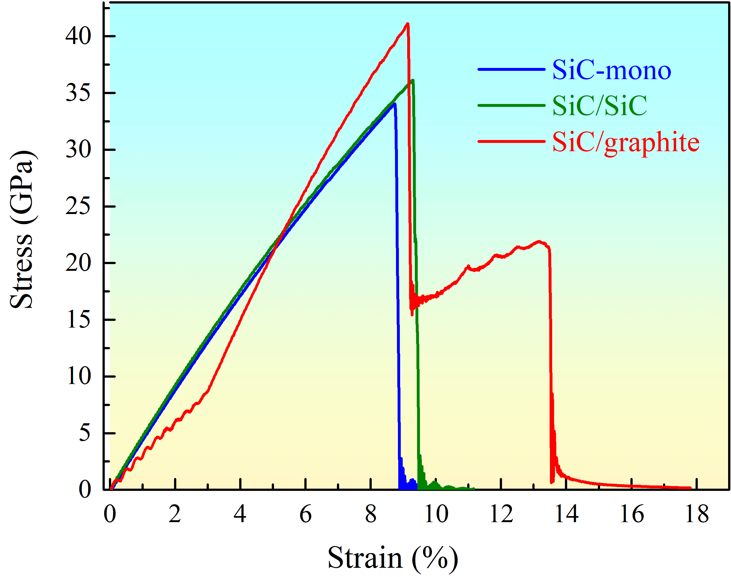
Mechanical Response and Crack Propagation

Slide 19
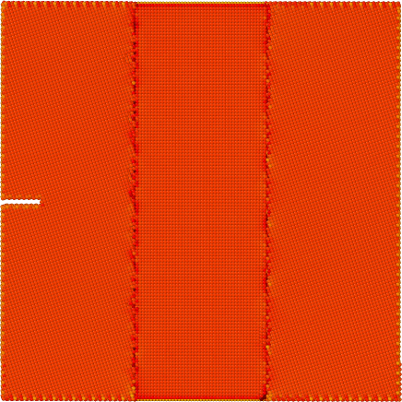
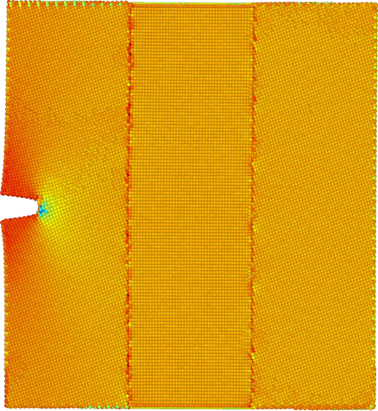
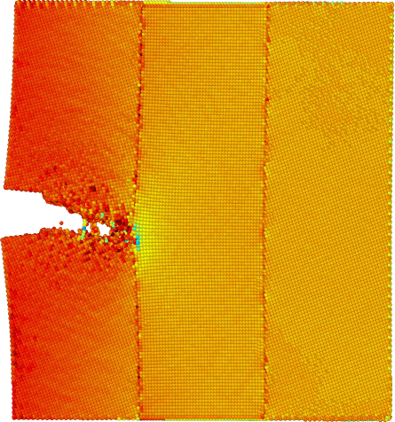
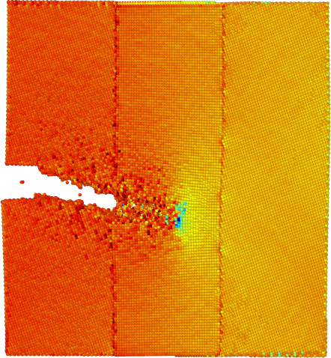
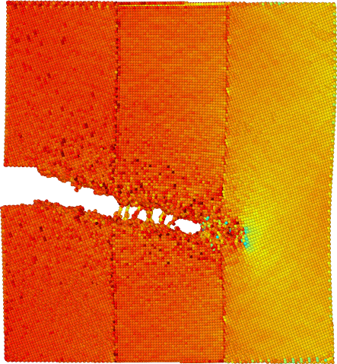
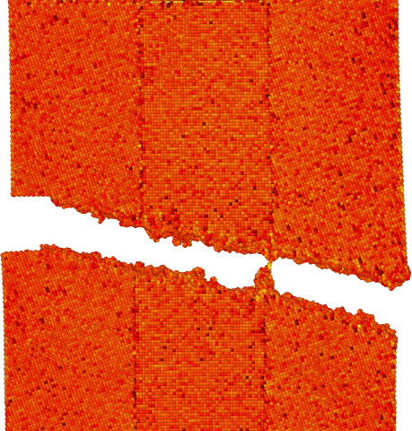
Mechanical Response and Crack Propagation
ε=0%
ε=9.2%
ε=9.4%
ε=9.7%
ε=9.9%
ε=10.1%

Slide 20
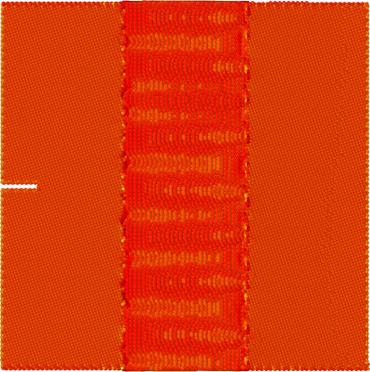
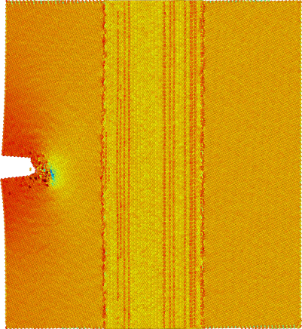
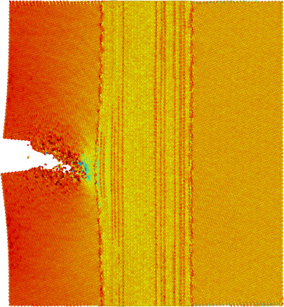
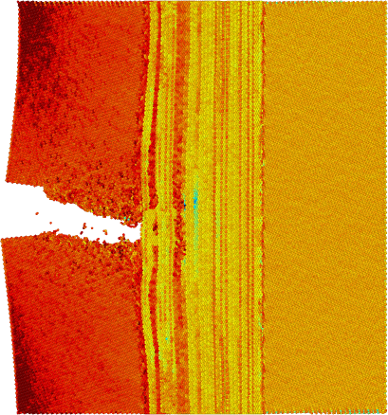
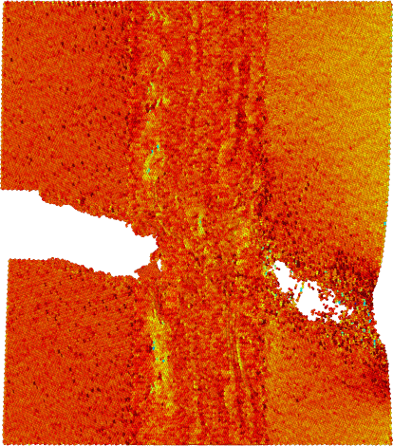
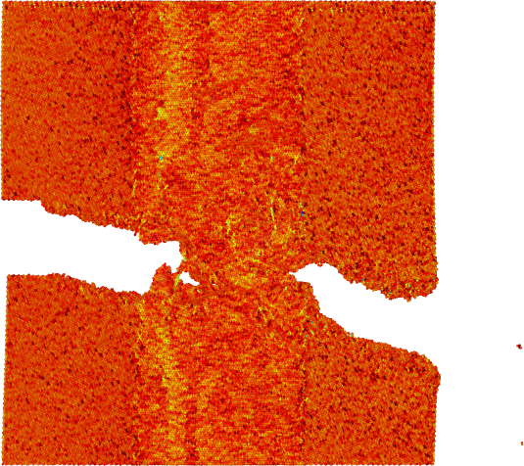
Mechanical Response and Crack Propagation
ε=0%
ε=9.5%
ε=9.6%
ε=9.7%
ε=13.8%
ε=14.0%

Slide 21
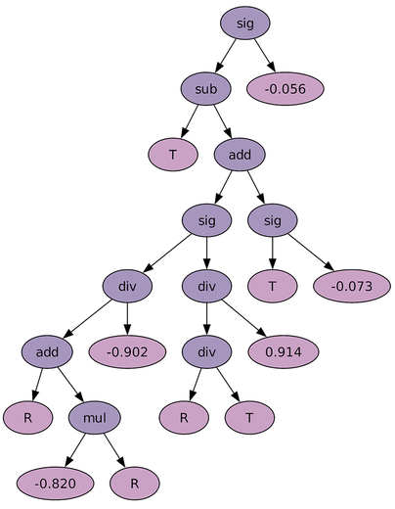
Machine Learning for Thermal Conductivity
Symbolic Regression
approximates the relation between an input and an output through analytic mathematical formula
Interpretability
Physical content
Suitable for small data sets

Slide 22
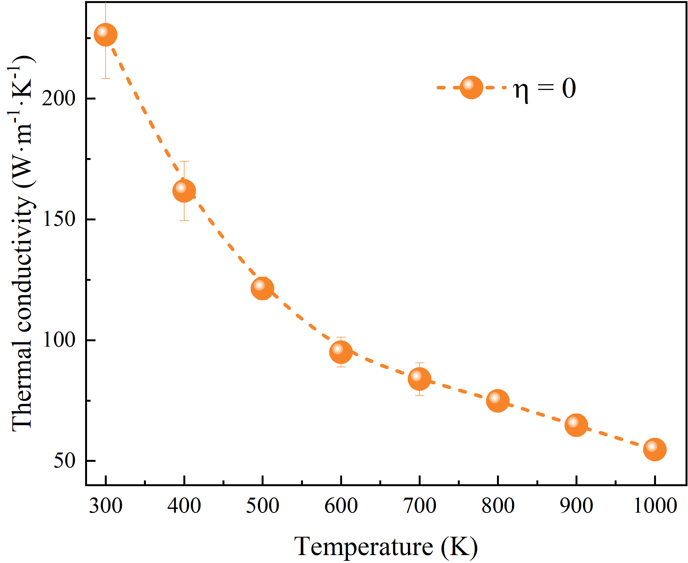
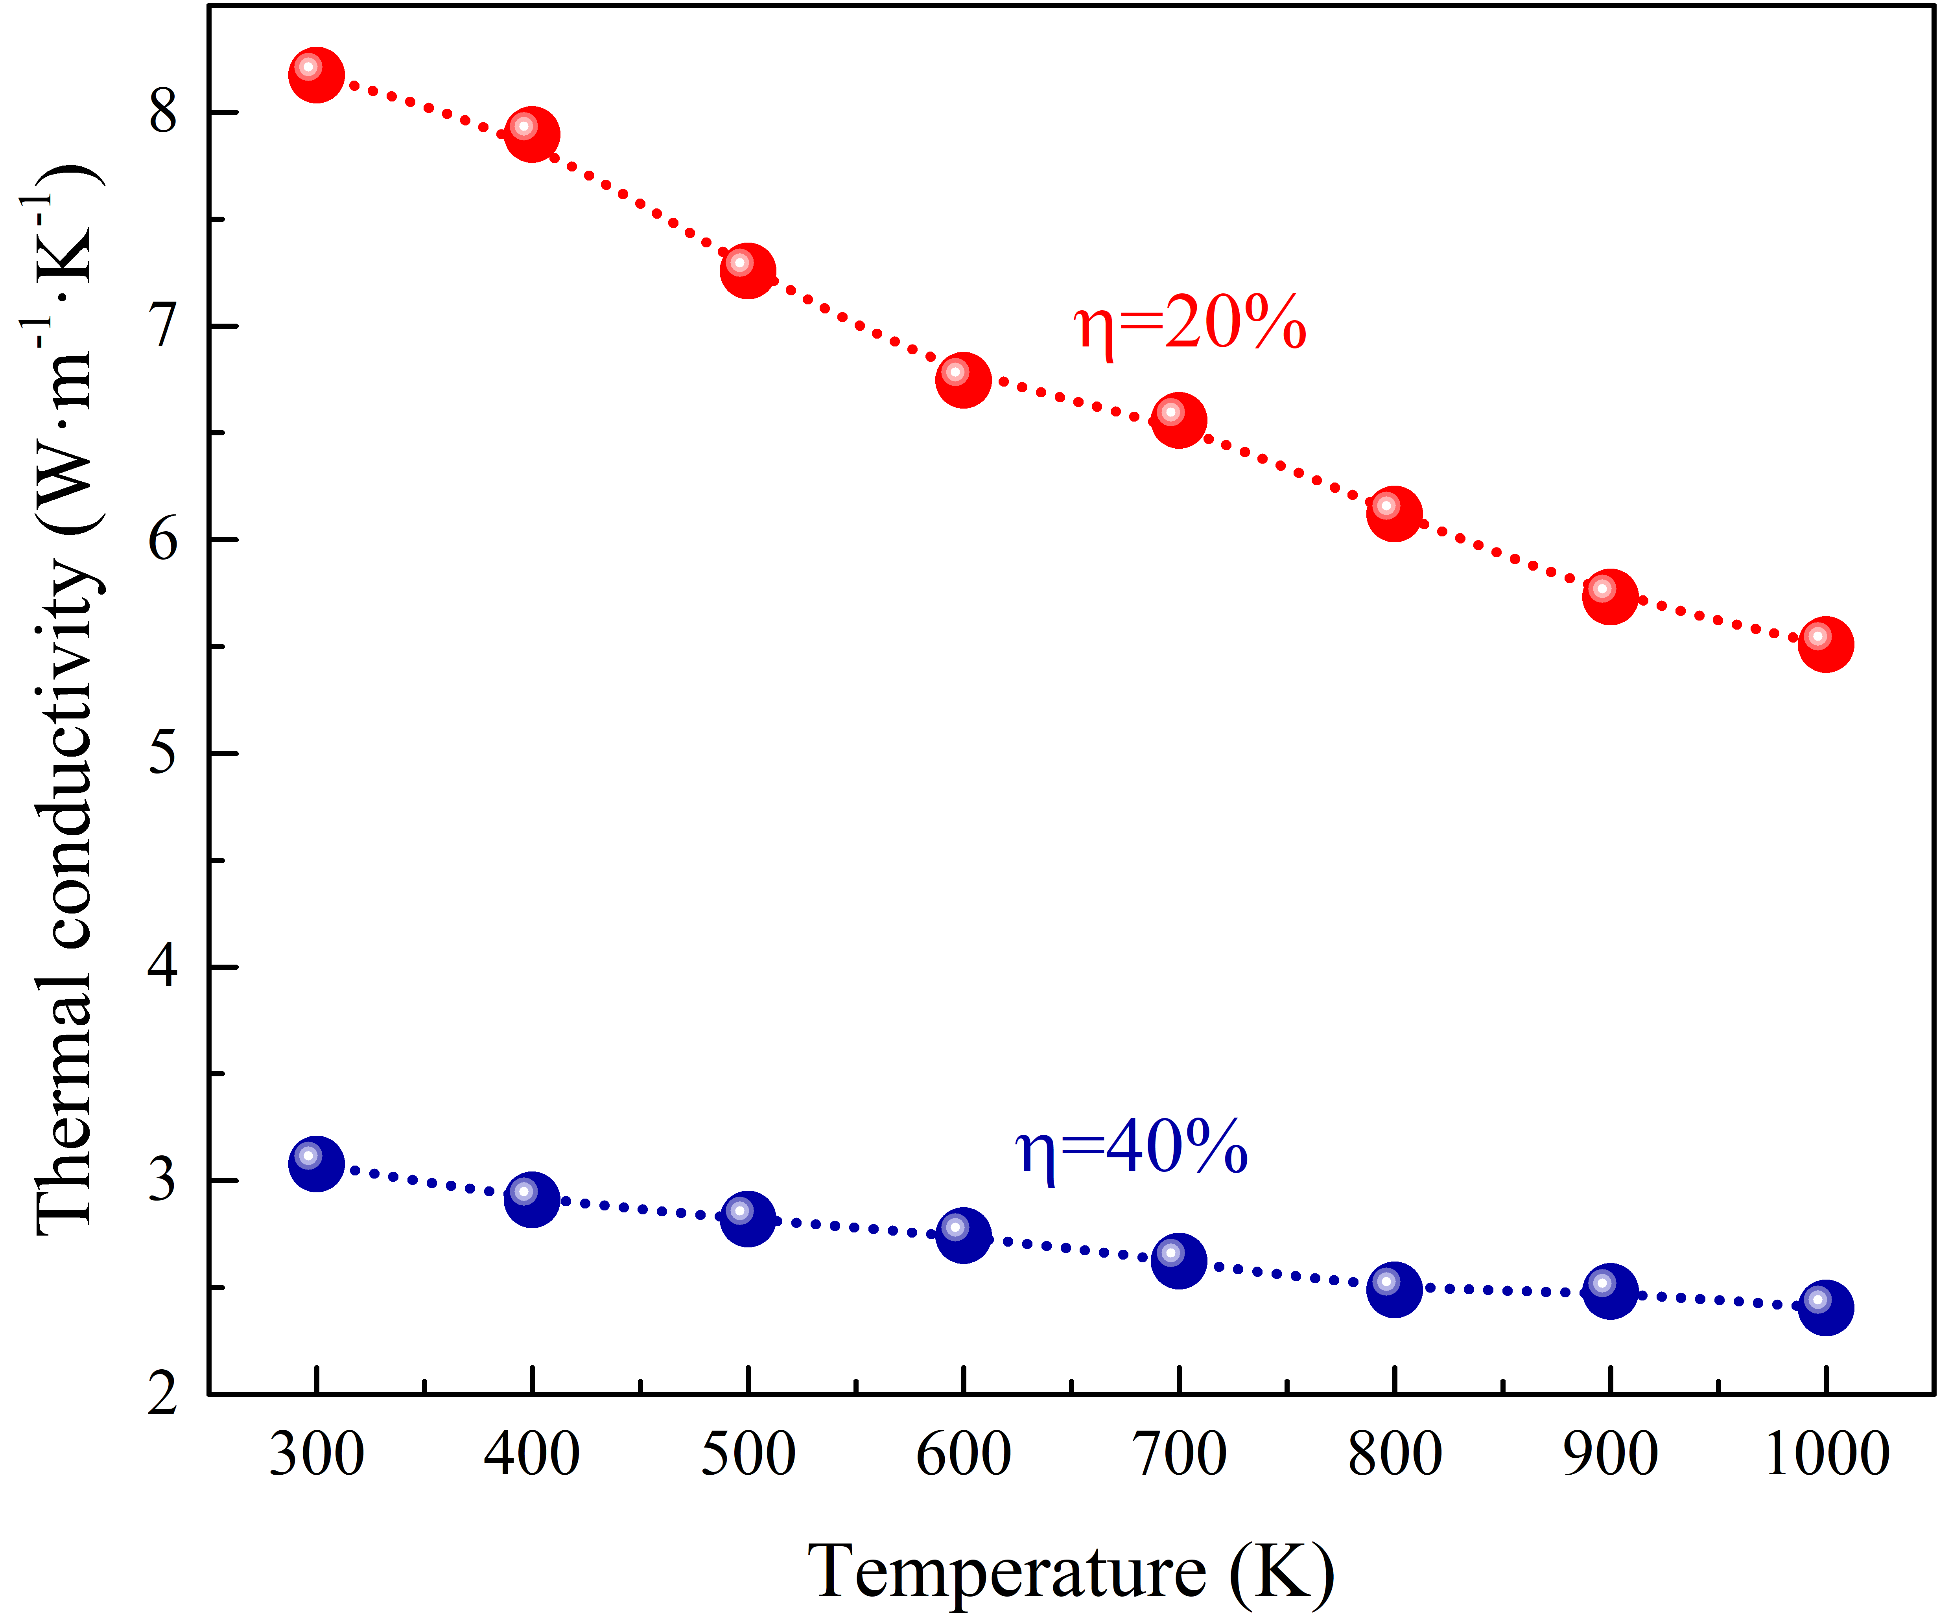
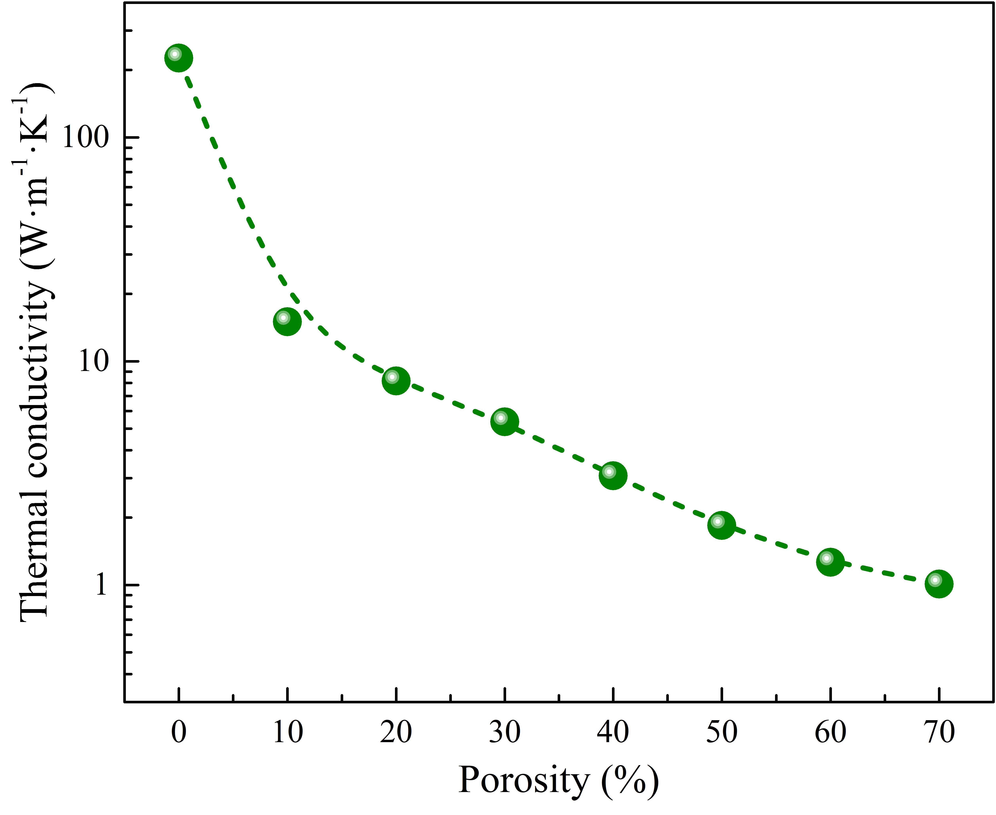
Machine Learning for Thermal Conductivity
Symbolic Regression
MD result:
SR result:

Slide 23
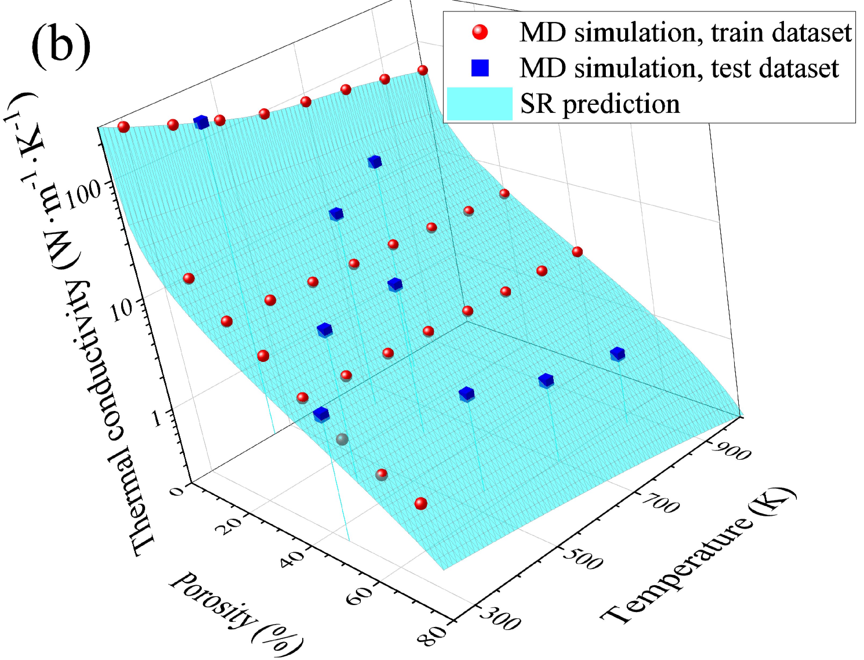

Machine Learning for Thermal Conductivity
Symbolic Regression

Slide 24


Machine Learning for Thermal Conductivity
Symbolic Regression

Slide 25




Machine Learning for Carrier Mobility in Si
Symbolic Regression
models for mobility in silicon
Brooks & Herring
Conwell & Weisskopf
Fletcher
Caughey & Thomas
Dorkel
Masetti
Arora
Klaassen (Philips)
Noor Mohammad
…

Slide 26












Machine Learning for Carrier Mobility in Si
Symbolic Regression
electron:
electron:
hole:
hole:

Slide 27




Machine Learning for Carrier Mobility in Si
Symbolic Regression
electrons, majority carriers
holes, minority carriers
APE to Klaassen's theory

Slide 28

Machine Learning for Carrier Mobility in Si
Symbolic Regression

Slide 29


Machine Learning for Thermal Conductivity
GB, RF, SVR

Slide 30



Machine Learning for Thermal Conductivity
GB, RF, SVR

Slide 31

Machine Learning for Thermal Conductivity
Physics-Informed Neural Networks

Slide 32

Machine Learning for Thermal Conductivity
PINN
Physics-informed convolutional encoder-decoder neural network maps

Slide 33









Machine Learning for Thermal Conductivity
PINN
TC = 130.3 W m⁻¹K⁻¹
TC = 83.02 W m⁻¹K⁻¹
TC = 15.73 W m⁻¹K⁻¹

Slide 34



Machine Learning for Energy-Conversion Structures
The primary task:
to quantify iron impurities in silicon solar cells using data derived from current–voltage characteristics
thermodynamic equilibrium
carrier injection

Slide 35

Machine Learning for Energy-Conversion Structures
Classic Regression
The workflow of the ML pipeline

Slide 36





Machine Learning for Energy-Conversion Structures
Classic Regression
SCAPS 3.3.11

Slide 37


Machine Learning for Energy-Conversion Structures
Classic Regression
Simulated data

Slide 38


Machine Learning for Energy-Conversion Structures
Classic Regression
Experimental data

Slide 39


Machine Learning for Energy-Conversion Structures
Computer vision
Simulation
Experiment

Slide 40

Machine Learning for Energy-Conversion Structures
Computer vision

Slide 41

Machine Learning for Energy-Conversion Structures
Computer vision

Slide 42





Machine Learning for Energy-Conversion Structures
Computer vision
Simulated data

Slide 43





Machine Learning for Energy-Conversion Structures
Computer vision
Experimental data

Slide 44
Summary and Conclusions

Slide 45
Future Work

Slide 46
Acknowledgements

Slide 47
Thank you
for your attention!

